Slide 1
Concurrency — Exercise 4
Rust I

Slide 2
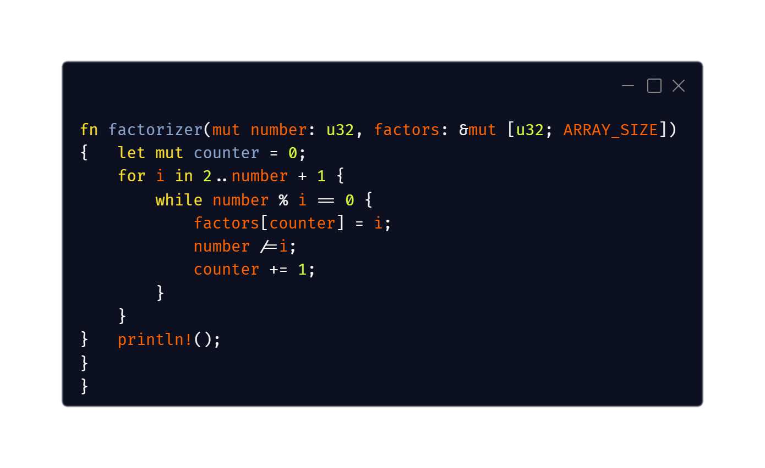
Problem 1

Slide 3
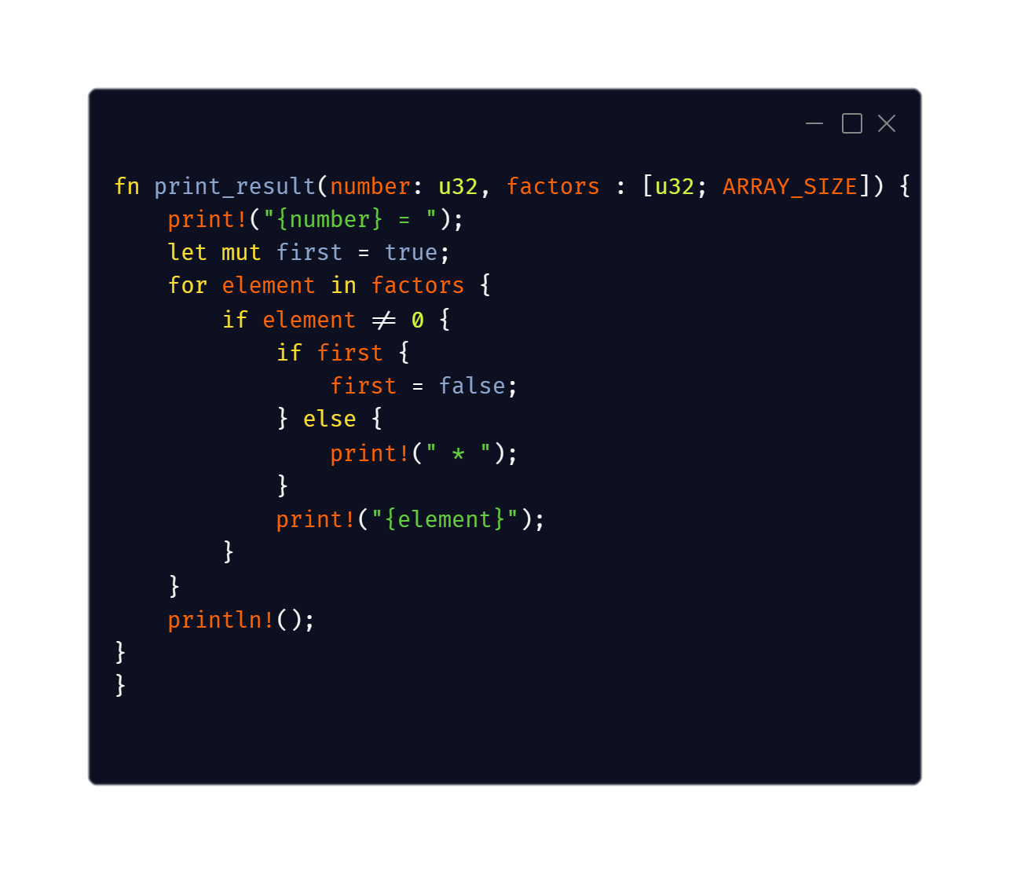

Problem 1

Slide 4
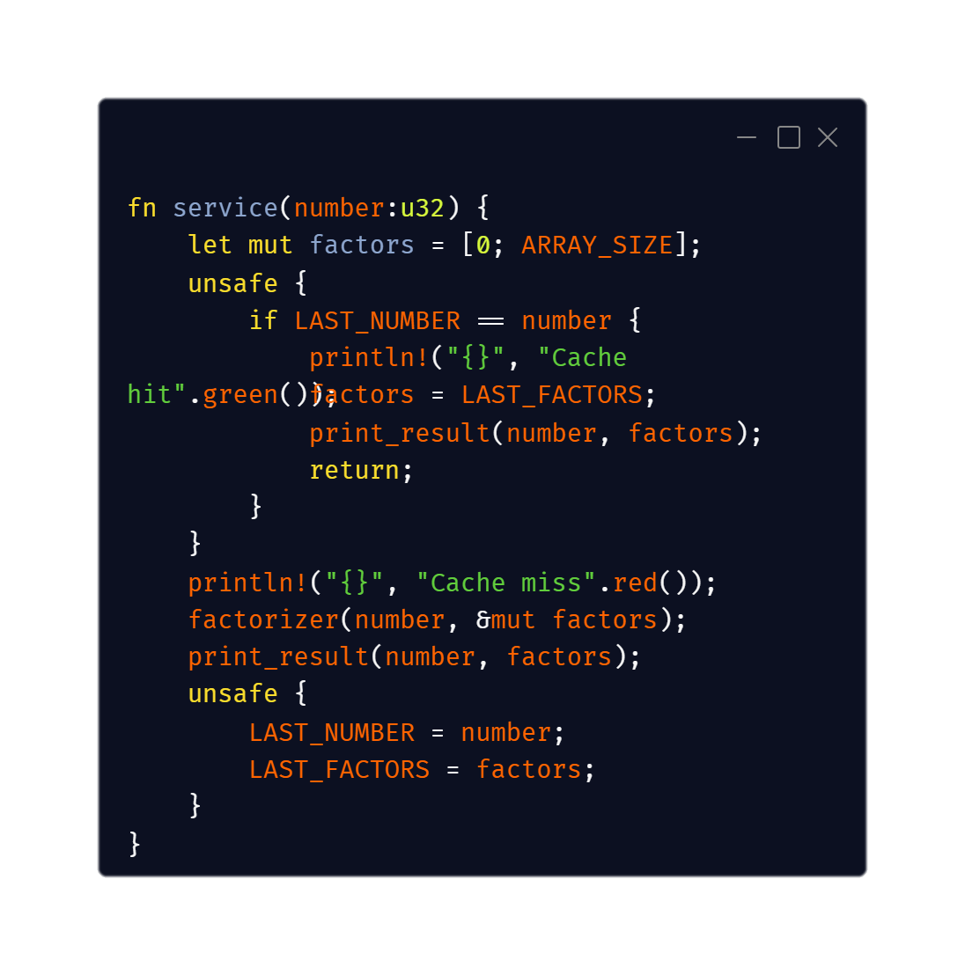
Problem 2

